Slide 1

GitHub Basics
A quick-start guide to using GitHub on Windows, Linux, or Mac

Slide 2
Why Use GitHub?
Storage: GitHub stores our code in one place, and allows us to access it from our devices
Version Control: Using GitHub, we can switch between multiple copies and versions
Collaboration and Sharing: GitHub allows us to share our code with others, and work on projects with other contributors

Slide 3
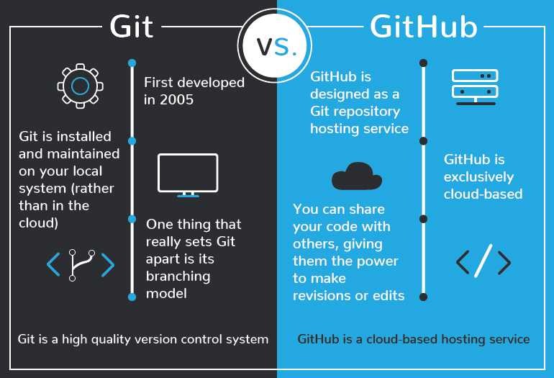
What is Git and GitHub?
Git is a version control system; it allows us to manage different versions (branches) of our project in a repository
If we write code that makes our program stop working, we can revert to a previous version in the repository
Git is a program installed locally to our computers, GitHub exists online (in the cloud), allowing us to access our repository from anywhere
Source: https://blog.devmountain.com/git-vs-github-whats-the-difference/

Slide 4
Installing Git and GitHub
Download Git from https://git-scm.com/downloads - follow the install instructions for your operating system
GitHub has a desktop GUI client for repository management without using the command line – you can download it at https://desktop.github.com/ for Mac or Windows or https://github.com/shiftkey/desktop (Unsupported and Unofficial) for Linux
We won’t use Git command-line here, but downloading will allow you to explore using it in the future

Slide 5
Key Terms and Commands
We will use some of the terms listed here; but they are all useful if you choose to explore Git’s command-line
Repository: The location where we store all our code
Branch: A particular copy of our codebase
Init: Initializes a project in the current directory
Add: Adds files to the staging area
Commit: Tells Git you are going to publish the files in the staging area, and assigns a message to the changes
Push: Sends the changed files and commit message to the online repository in the cloud (github.com)
Pull: If the online repository contains changes that are not on your local machine, pulling will get those changes and update your local code to the newest version

Slide 6
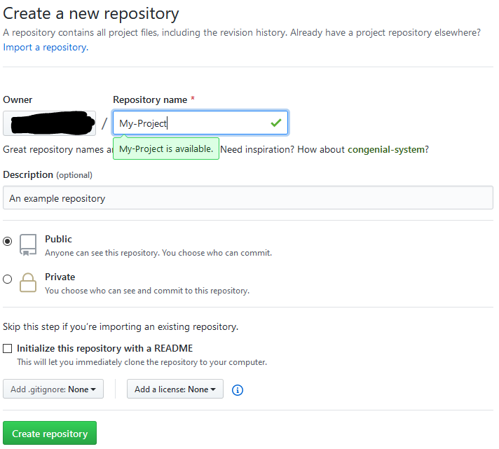
Example Using GitHub Desktop
Create a GitHub account and log in
Under the repositories tab, click on ‘New’
You can also change whether your repository should be ‘Public’ or ‘Private’

Slide 7
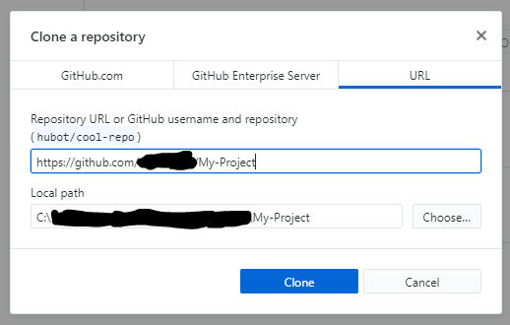
Example Using GitHub Desktop
On the next screen, we can click the “Set up in Desktop” button to start setting our project
This will open the following screen in GitHub Desktop
The first input is the location of your remote repository – leave this the same
The second input is the location of your local repository (where the project will be stored on your computer)

Slide 8
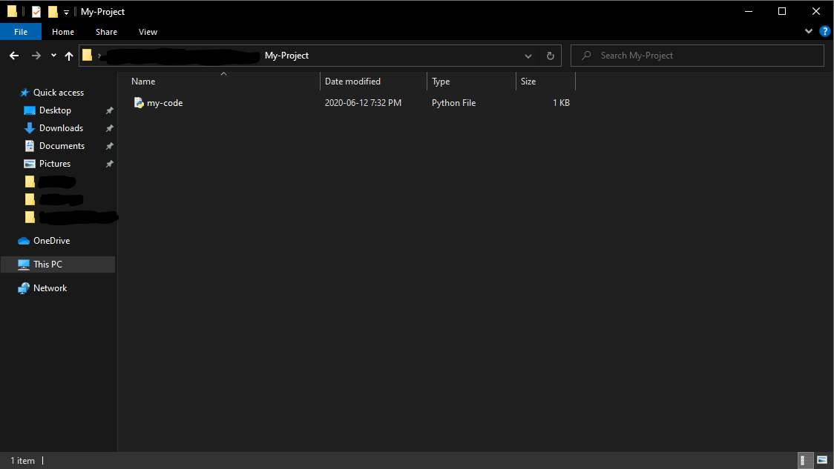
Example Using GitHub Desktop
Next, open file explorer / finder and copy your code into your project folder
When you open GitHub Desktop, you will see your file is ready to be sent to the remote location

Slide 9
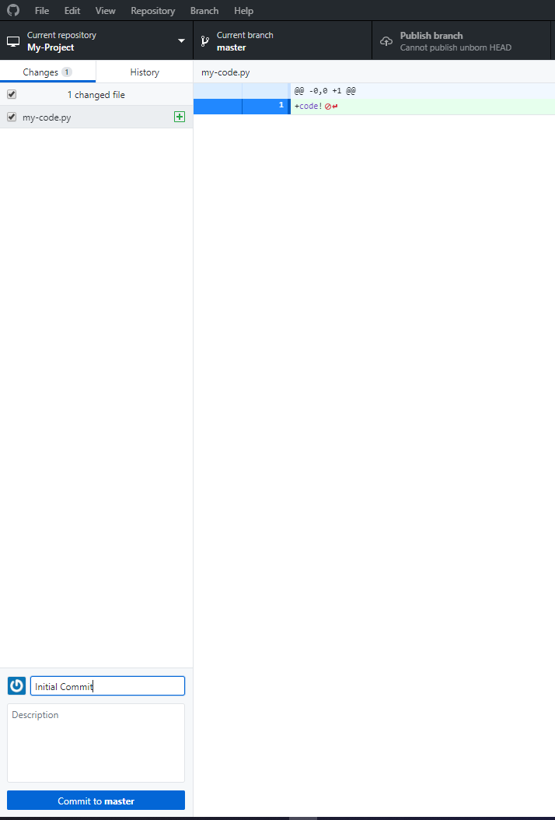
Example Using GitHub Desktop
The right hand side shows the changes in the file
The sidebar shows the files that have been added/changed
Write a message that communicates what code you have changed, for example “Initial Commit” and press “Commit to master”

Slide 10
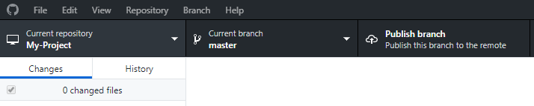
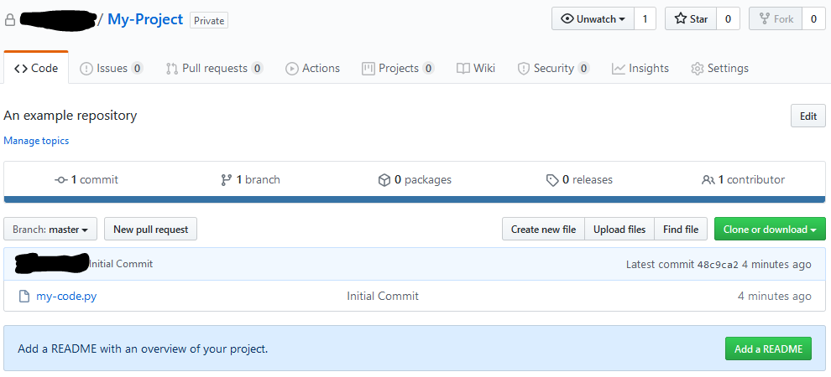
Example Using GitHub Desktop
Now that our changes have been committed, we can push (publish) them to our remote location with “Publish branch”
You can now go to github.com/your-username/your-project in your web browser, and see your new repository
Feel free to add a README – a document that gives a brief description of what your project was

Slide 11
Conclusion
Git is a version control software, and GitHub is a powerful tool and hosting service that allows us to store our code online
We can use either the command-line or GitHub Desktop to manage our online repositories
Now that you now a few basic Git and GitHub concepts, feel free to explore the Git command-line using your new knowledge!

